Slide 1
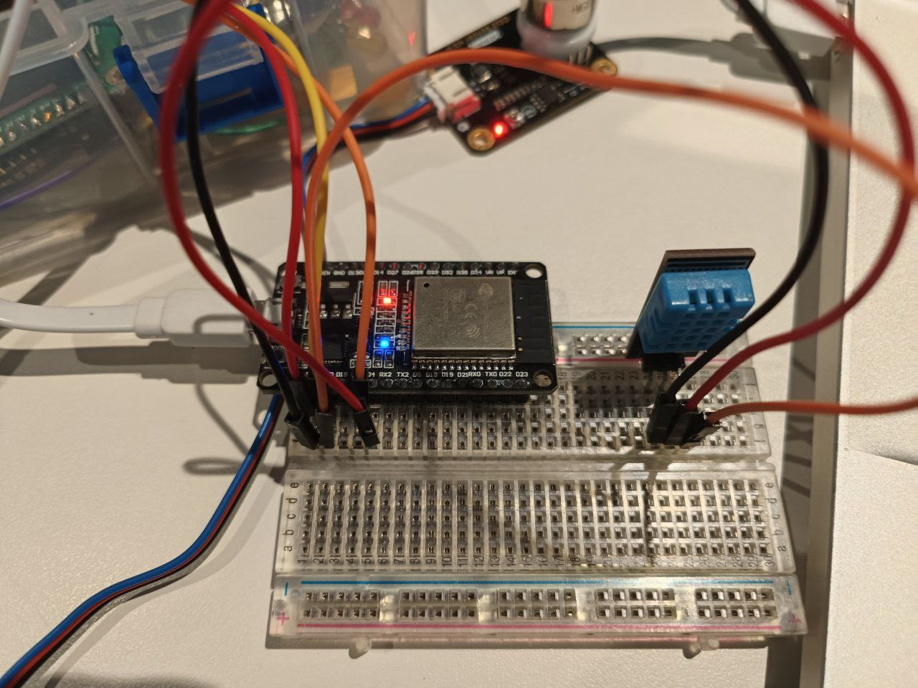
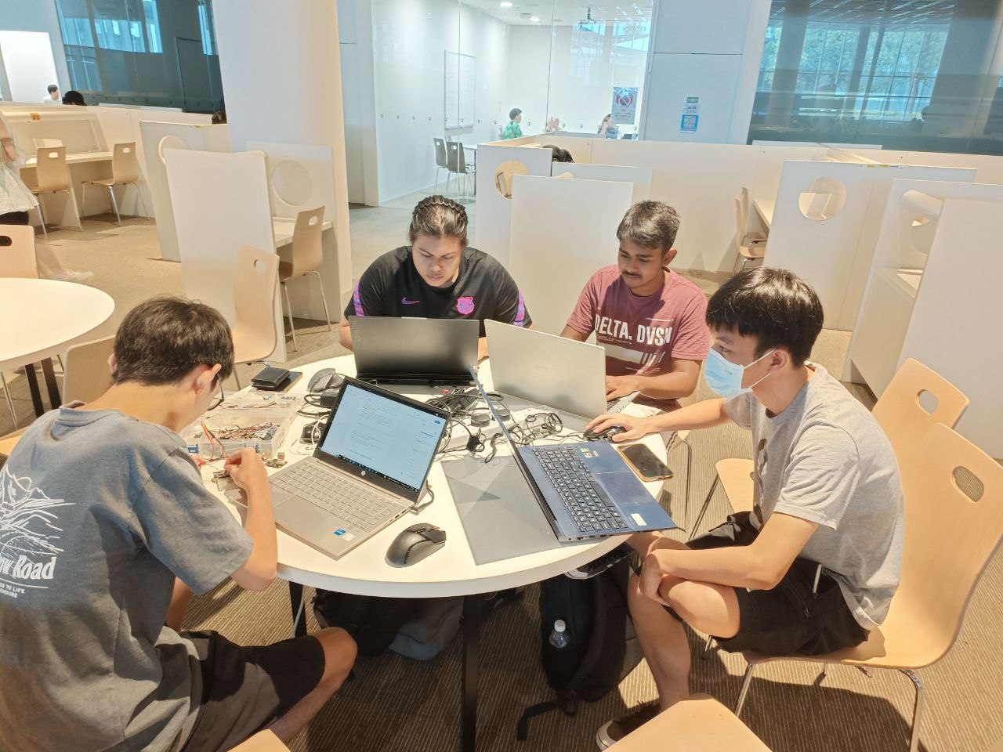
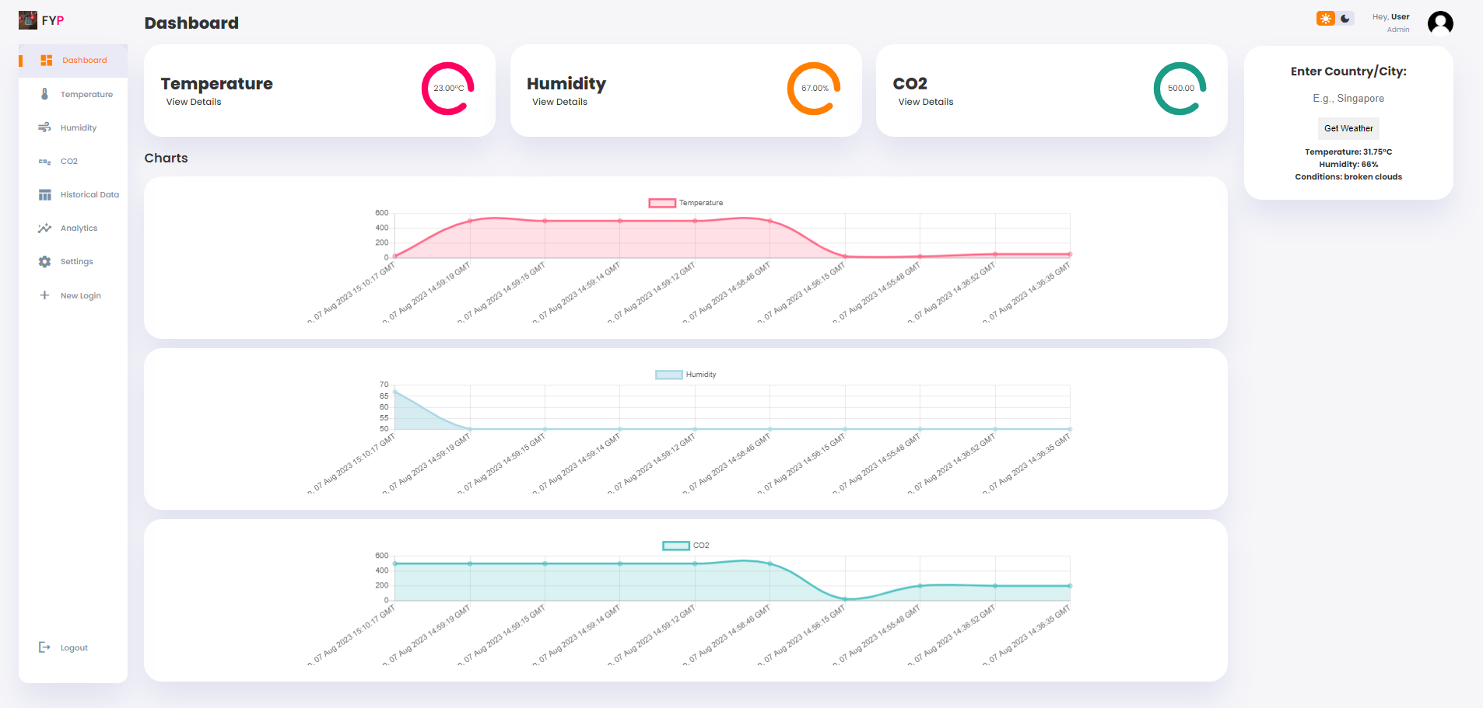
CO2 Monitoring IoT System via Sigfox Network Partner Organisation: Name of Organization (*Delete line if not applicable)
Project Overview
Problem: The agricultural industry faces challenges in optimizing crop growth and yield due to fluctuations in environmental parameters like temperature and CO2 levels. Existing monitoring systems may lack real-time data updates, accessibility, and integration with cloud platforms. Therefore, there is a need for an advanced CO2 monitoring IoT system that provides real-time data insights and alerts to farmers, enabling them to make informed decisions and improve agricultural practices.
Requirements: Hardware: Arduino, Sigfox Shield, CO2, and temperature sensors for data collection. User-Friendly Dashboard: Real-time and historical data visualization. Data Storage: Local and cloud storage for data persistence and remote access. Data Analytics: Tools for trend analysis and reporting. Alerting System: Notify users of abnormal conditions via email and Telegram. Security: Login/logout functionality for secure dashboard access. Customizable Alerts: Configure alert parameters based on sensor types.
Solution: Build a CO2 monitoring IoT system for efficient data transmission. Collect data from CO2 and temperature sensors and store it locally and in the cloud. Create a user-friendly website dashboard for real-time data display. Implement analytics for threshold Include customizable alerts via email and Telegram for abnormal conditions.
Technologies: Arduino for sensor interfacing and data collection. Python for data upload to cloud services. XAMPP and PhpMyAdmin for local data storage. MongoDB for cloud-based data storage and management. Cloud services for data visualization. HTML, CSS, and JavaScript for website dashboard development. Data analytics tools for trend analysis and reporting.
Email and Telegram API for alert notification integration.
Team Members
Nguyen Minh Khang, Afzal Haziq Bin Azman
Nagarajan Nishanth Arjun, Tee Tian He
Supervisor
Mr Joshua Tan
Website
Notes:
NOTES
Refer to write ups in ‘Past Projects for Reference’ Booklet for Project overview write ups - Student Academic - Project (sharepoint.com)
ENGLISH – British. E.g. organisation VS organization
Font: RP approved font - Arial family only.
Header: Arial Bold
Copy text: Arial regular or Arial Bold. Use Emphasis of SOI’s orange colour in moderation.
Picture frame – Give a 4.5 or 6pt orange outline.

